Slide 1

MPC for Robotic Arm Path Planning and Control
ECH 267 Final Project
Jonathan Dorsey

Slide 2
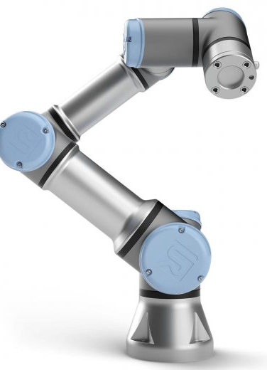
Introduction
Explore use of MPC for Control and Planning of Robot Arm
Identify challenges specific to robotic manipulators.

Slide 3
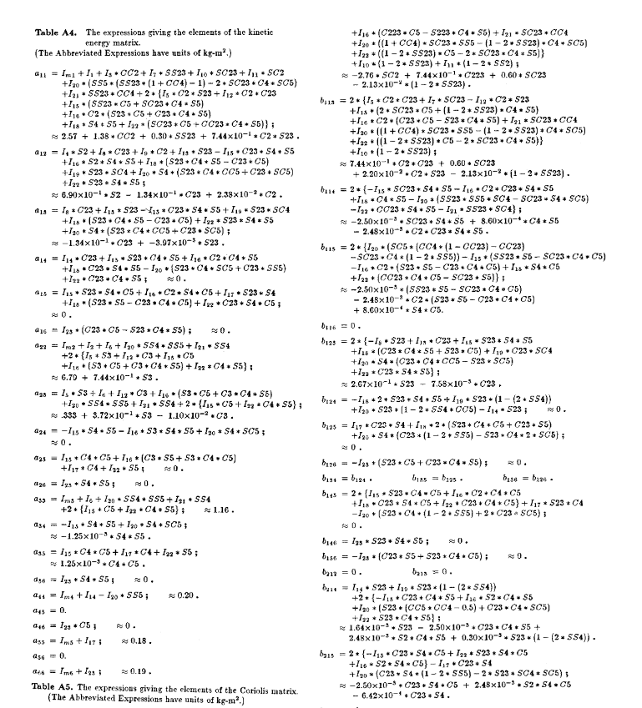
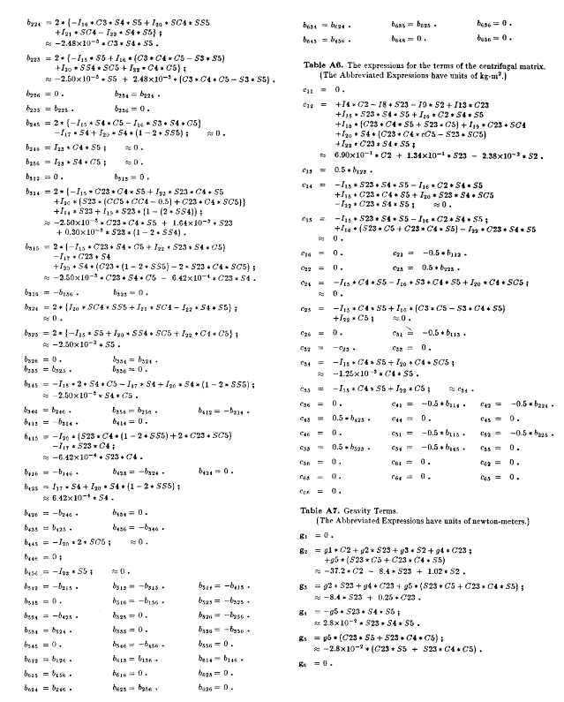
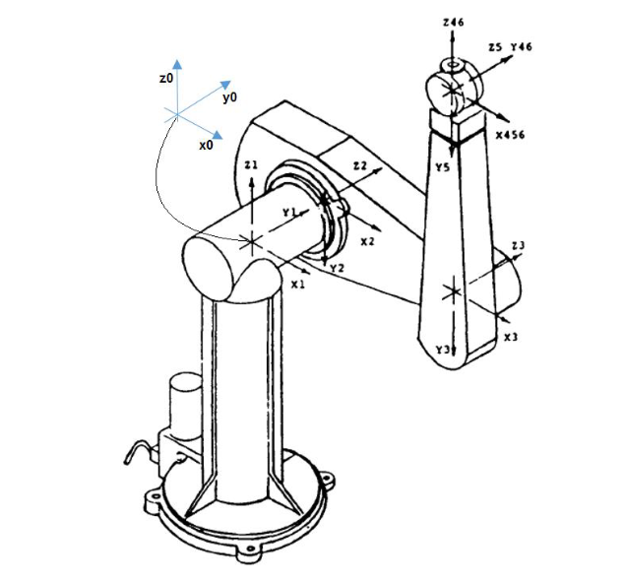
Which manipulator ?

Slide 4
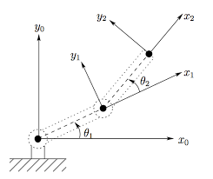
Which manipulator ?
2 Link – Planar Robot Manipulator
Links are individual actuated & subject to gravity
Motion is restricted to the vertical plane
Simple, intuitive, and easy to troubleshoot
Dynamics are straightforward to derive

Slide 5
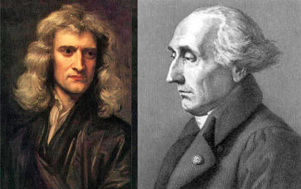
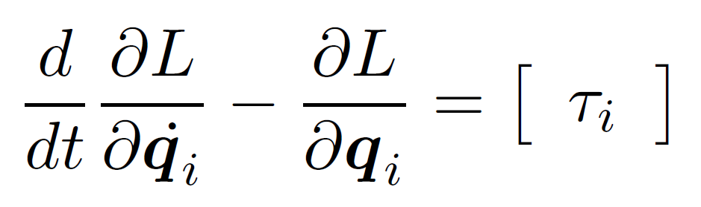
Deriving Equations of Motions
Typically obtained using Lagrange Equation or Newton-Euler Equations
Use Lagrange Equations for Simplicity

Slide 6
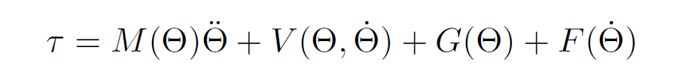
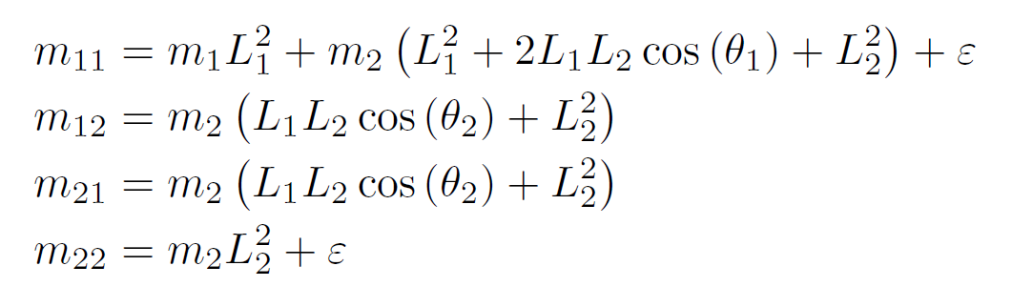
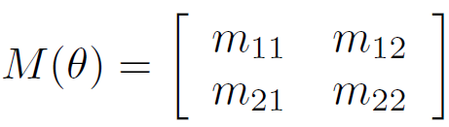
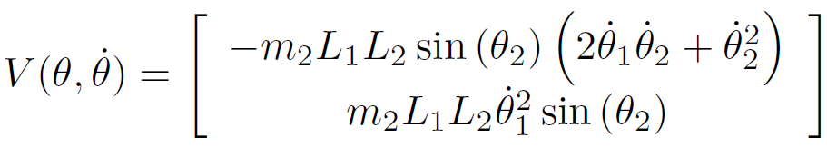
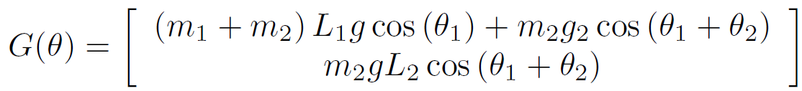
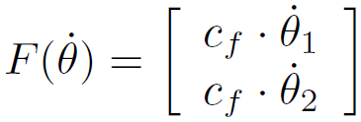
Dynamics for Serial Robots

Slide 7
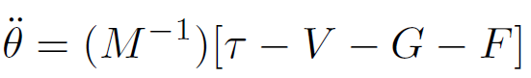
Robot Dynamics: Take-Aways
Equation of Motion are nonlinear
Links are coupled. Positions and Velocities are dependent on the motion of links in the system

Slide 8
Model Predictive Control for Planar Robots
Control
Path Planning
MPC is the desirable choice for MIMO system control
Natively handles constraints.
Flexible and intuitive formulation, can easily be used to develop control objectives (e.g. avoiding obstacles)
Robots are often fully sensored and do not typically require real-time state estimation.
Determine the function of position from point A to point B, high dimensional space
Path planning for external control (supervisory -> low level )
Ease and simplicity of Path generation

Slide 9
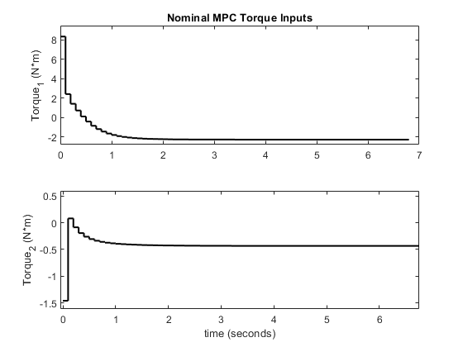
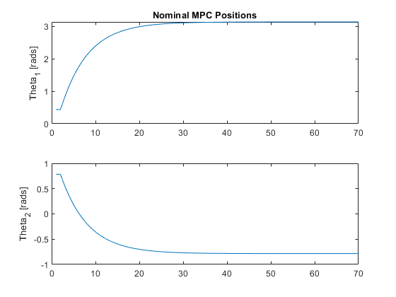
Pose to Pose Control via MPC

Slide 10
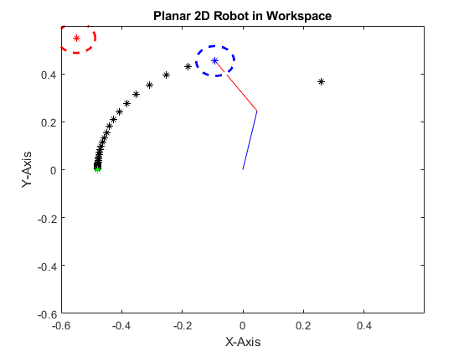
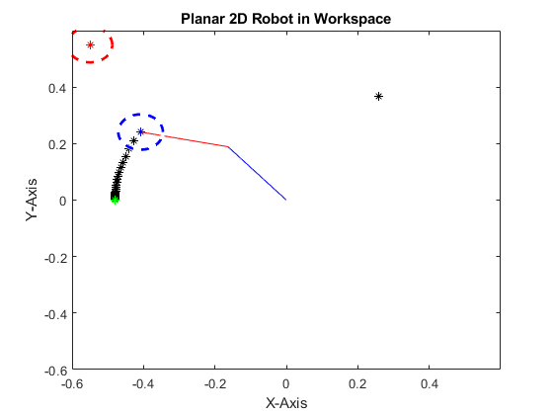
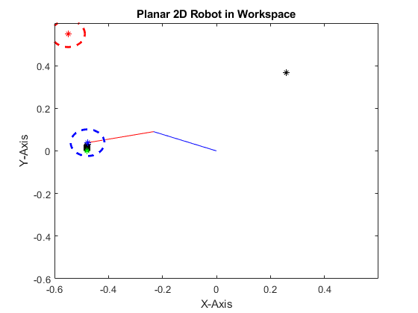
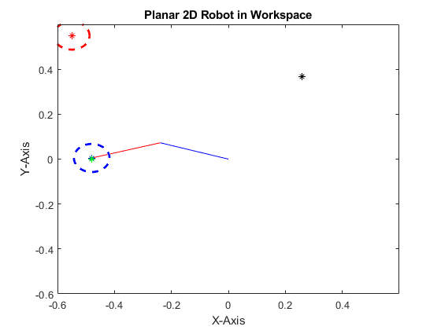








Slide 11
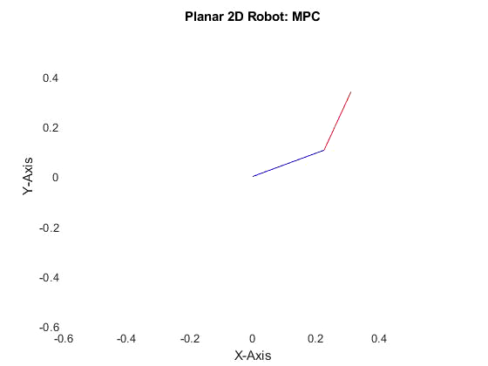
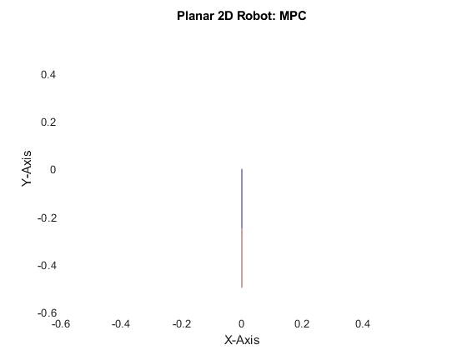
MPC in Action: 2 Link Robot Sim.

Slide 12
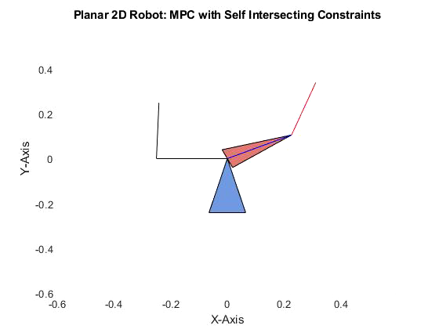
Range of Motion Constraints
Feasible Goal Pose
Robots can often have physical limitations on range of possible motions.
This can be implemented by adjusting the bounds of the inequality constraints for the angular position states of the robot.

Slide 13

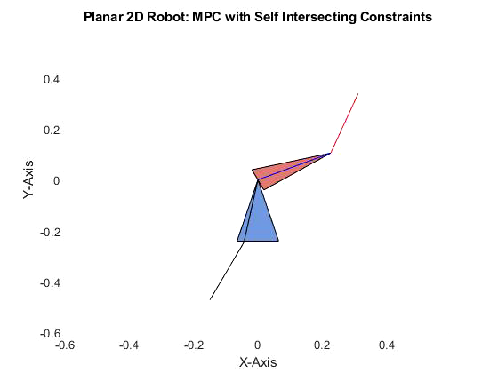
Infeasible Goal

Slide 14
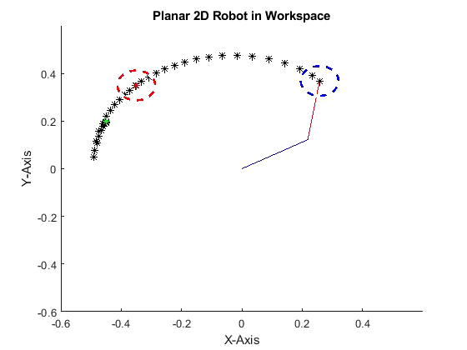
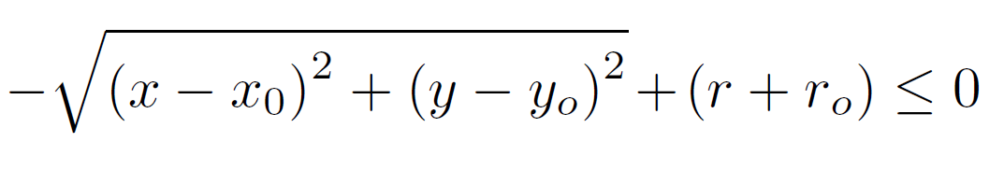
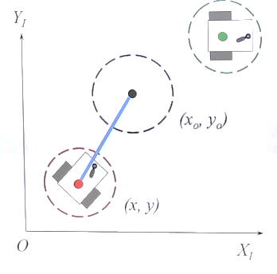





MPC - Obstacle Avoidance
By adding term to the Cost function, we can achieve rough obstacle avoidance behavior. (Could also be added as an extra constraint)

Slide 15
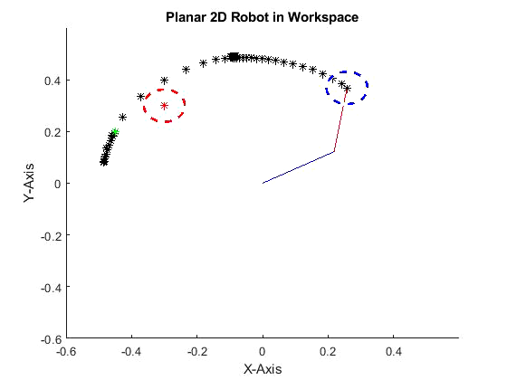
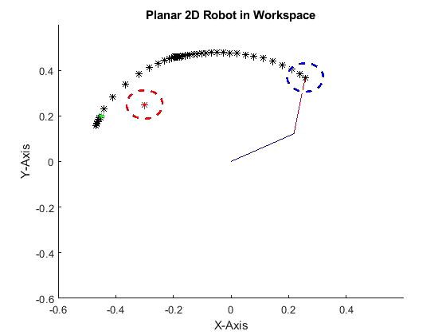
Inconsistent Behavior for Obstacle Avoidance

Slide 16
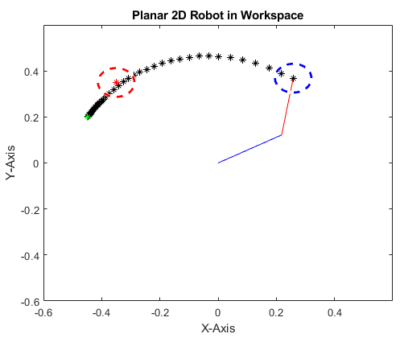
Challenges for Obstacle Avoidance
Penalty vs Constraints
Penalty will incentivize the control to avoid the area
Constraints will restrict the system from entering infeasible positions.
Local Minima

Slide 17
MPC for Path Planning
It is often desirable to know the path the system will take, and/or control the mechanisms and parameters which generate this path (shortest, minimal energy, distance from obstacle…etc.)
MPC can be used as means of path planning by leveraging the prediction horizon at each iteration as a feasible path from a starting pose to and goal pose.
Multiple Shooting returns both optimal state & actions over prediction horizon according to model.
These states in the prediction horizon can be used to define a smooth path between two points in space, which other controllers or system can sample at any arbitrary resolution.
MPC is fundamentally different than other planning algorithms in use such as A*, Dijkstra, RRT, D*, PRM, Artificial Potential Fields…etc. (Graph/Heuristic based)

Slide 18
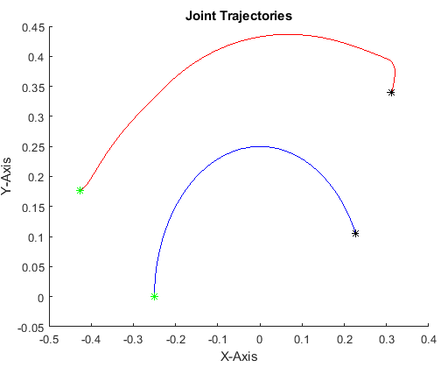
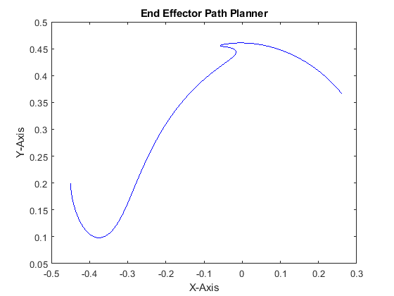
Benefits of Path Planning using MPC

Slide 19
Path Planning with Obstacle Avoidance
It is desirable to avoid obstacles which occupy the most direct path from one pose to another.
Define minimum distance from object inequality constraint.
Heavily penalize violations of minimum distance from object

Slide 20
Problems with MPC Path Planning
While robust (due to feedback) the solutions times can vary drastically (<50ms per step -> 10 seconds per step) even when only considering stationary objects.
MPC formulation can affect the performance
Added Inequality constraints
Slack Variables
Heavy penalty in loss function

Slide 21
Conclusion
MPC is a very flexible controller architecture, for robotic systems (MIMO, constraint handling…etc.)
Can be used to achieve nontrivial control objectives (obstacle avoidance…etc.) for complicated dynamic systems
MPC provides a unique method for path planning which has all the benefit of MPC for control without the draw backs of heuristic/graph search methods.

Slide 22
Thank you!

